Slide 1


Slide 2
Assumptions
Marketing Objective: You are running an advertising campaign with the goal of signing up students for the Digital Marketing Nanodegree
Cost: The cost of the degree is $999
Profit: For the purpose of this assignment, assume a profit margin of 30%, meaning that Udacity makes $299 in profit per student that signs up.
Campaign: We want to aggressively grow the program, but, we want to do it without losing money.

Slide 3
Formulas:
Conversion Assumption: 0.2% Conversion via Landing page
Calculating #of Sign Ups: Clicks to the landing page *0.002 = # of Student Sign Ups
Note: Please round to the nearest whole number
CPA: Cost of Campaign/# sign ups = CPA
Note: Please round to the nearest cent
ROI: [(299 Profit) - CPA] * # of Student Sign Ups = ROI

Slide 4
Part 1
Evaluate a Display Image Campaign

Slide 5
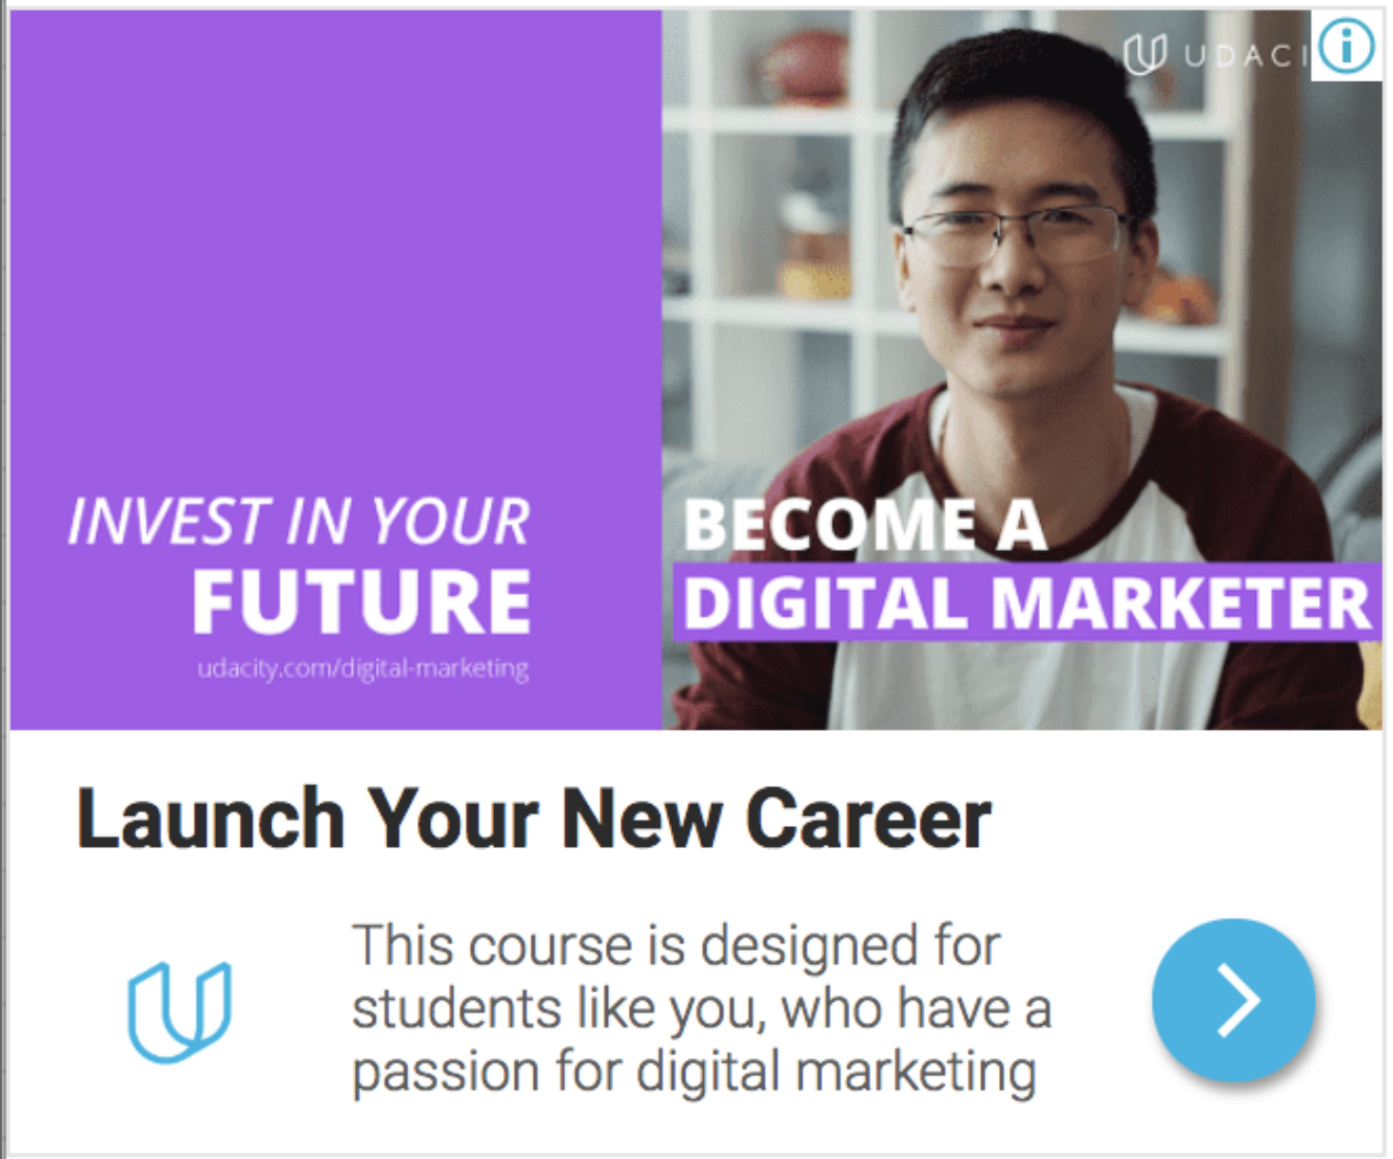
Display Image Campaign: Overall Results
Find below the overall results of the Display Image Campaign targeting the Affinity Audience. The Affinity Audience consisted of Business Professionals Social Media Enthusiasts.

Slide 6
Results:
Calculate the ROI
Campaign had positive ROI of $149.05
Creative | Clicks | Impressions | CTR | Avg CPC
Campaign Results | 1243 | 200,957 | 0.62% | $0.36
Cost | Conversion Rate | # New Students | CPA | ROI +/-
4$$$448.95 | 0.2% | 2 | $224.48 | +$149.05

Slide 7
How would you optimize this campaign?
Suggestion 1: change of Ad copy's headline
The campaign target audience is “ Business professional social media Enthusiast”. The ad might be pointing at professional who are already working, the headline also resonates with people that want to “launch a new career” I will reframe the headline as “Acquire digital marketing skills” for those that are not changing career path
Suggestion 2: Demographics
The Ad copy shows a male student which doesn't appeal to female student I will try to bring the demographic to point at the age and gender
Suggestion 3: Change to Target Audience
I will try targeting other audiences than “business professional social media enthusiast” making it “digital marketing “

Slide 8
Part 2
Evaluate a Display Image Campaign

Slide 9
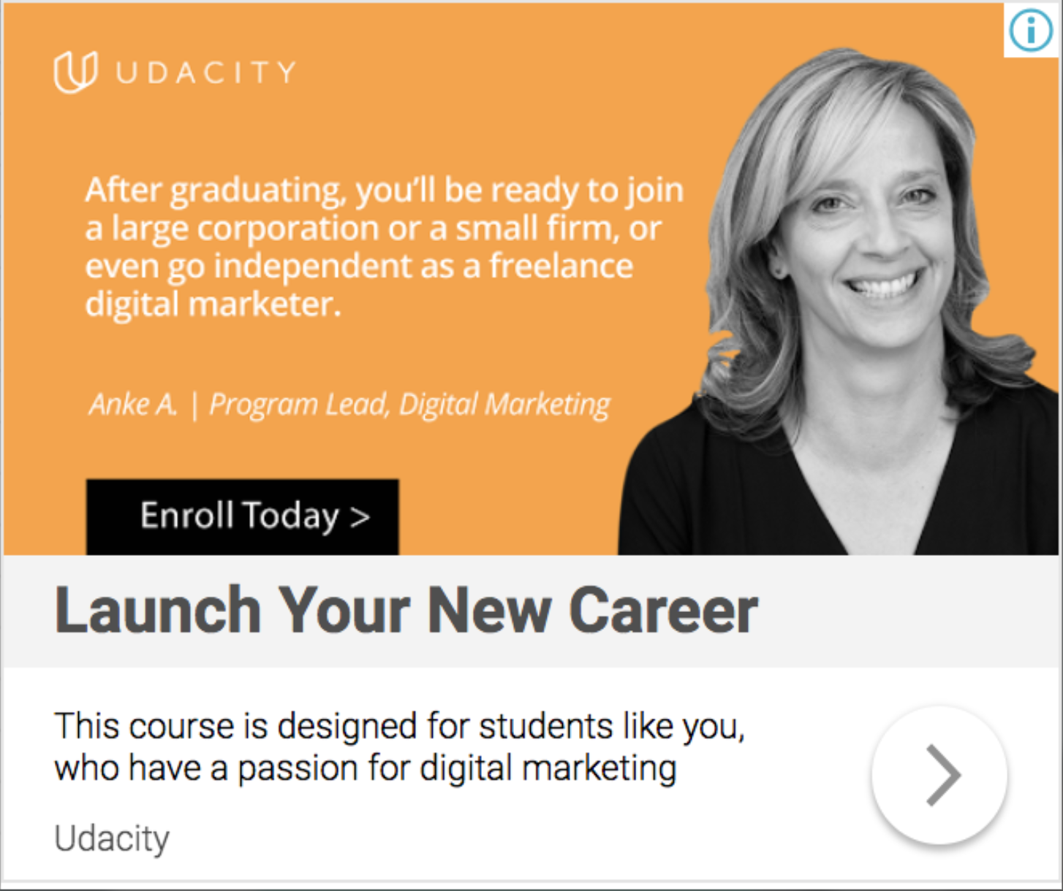
Display Image Campaign: Site Targeting Find below the overall results of the Display Image Campaign targeting placements (site targeting). This audience consists of the Digital Marketing partners’ landing pages.

Slide 10
Results: Calculate the ROI
Campaign had a positive, but how ever the ROI is low and it is $67.01
Creative | Clicks | Impressions | CTR | Avg CPC
Campaign Results | 407 | 67833 | 0.6% | $0.57
Cost | Conversion Rate | # New Students | CPA | ROI +/-
$231.99 | 0.2% | 1 | N$231.99n m | +$67.01

Slide 11
How would you optimize this campaign?
Suggestion 1: change Ad Copy (Title)
The write up is too long and takes up a lot of space. I will try making it short so that it won't be too lengthy So the target audience won't leave the page, I would talk about the benefit of digital marketing.
Suggestion 2: Change Ad Copy (Description)
Telling the student in the description part of Ad Copy about them having passion for digital marketing doesn't correlate with the lengthy content I will make it correlate with each other by including in the description “learn from real professional s.
Suggestion 3: A/B test colours
The colours used is a good colour orange and black. I would try colour that is appealing to the eye or colour that is calm to look at and colour that flows with website or landing page.

Slide 12
Part 3
Evaluate a Display Image Campaign

Slide 13
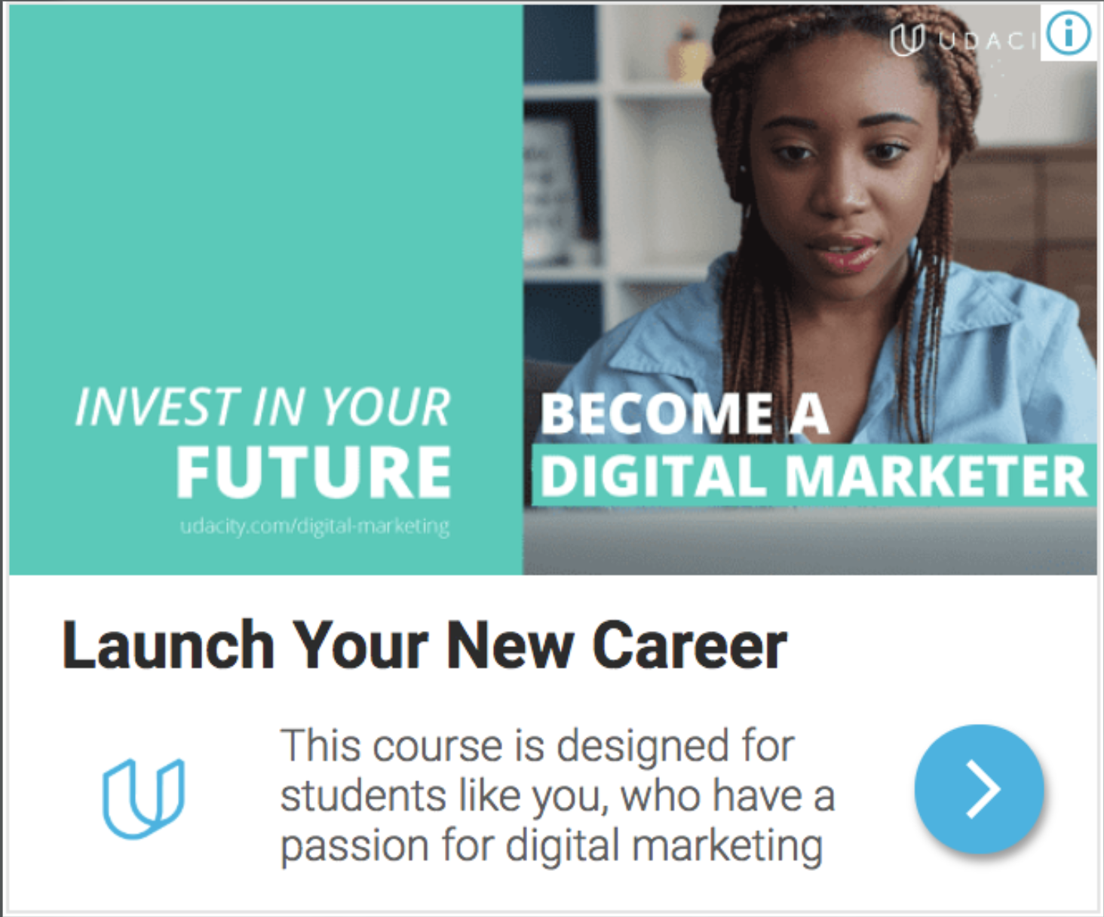
Display Image Campaign: Overall Results
Review below the overall results of the Display Image Campaign targeting visitors to the Digital Marketing Nanodegree Program landing page

Slide 14
Results: Calculate the ROI
Campaign result was positive but had a low ROI of $64.50
Creative | Clicks | Impressions | CTR | Avg CPC
Campaign Results | 670 | 109994 | 0.61% | $0.35
Cost | Conversion Rate | # New Students | CPA | ROI +/-
$234.50 | 0.2% | 1 | $234.50 | +$64.50

Slide 15
How would you optimize this campaign?
Suggestion 1: A/B testing colour
The colour combination of green and light blue is a good colour but it is commonly used by developer s i will like to suggest that they use colour that will prompt people to take action
Suggestion 2: Ad creatives
The image should show more than just one Face it can show many female faces which will be more appealing the female gender and a look a larger audience
Suggestion 3: change Ad copy
The campaign is majorly for student who likes or has passion for digital marketing I would try change the description to enroll now and become a digital marketer.

Slide 16
Part 4
Results, Analysis, and Recommendations

Slide 17
Which campaign performed the best? Why?
The best performing campaign among the three presented was the campaign targeting the AFFINITY AUDIENCE. It had the largest number of clicks ie 1243 to 407 and 670 for the second and third campaign respectively . There was also a record of student’s sign up which was 2-1-1 respectively . The ROI was positive for all three campaigns but the affinity audience was more positive than the remaining two campaigns the value was given respectively $149.05 , $67.01 , $64.50.

Slide 18
Recommendations for future campaigns
The first campaign performed the best I would focus on the affinity audience I will utilize the success and stop other campaign
I would like to narrow down the ad copy headline, narrowing Target group the demographics
I will use inpersonalized image about digital marketing, I will a/b test colours of the campaigns to find suitable combinations of colours for landing page.
Yes I would like to change the description of the page ,the color and that it that the colour of website should not be too different and that the landing page should contain necessary information that would lead and give an idea of what the landing page is all about.

